Slide 1

Natural Language Processing DLO 8012
Subject In-charge
Ms Vincy Joseph
Assistant Professor
email: vincyjoseph@sfit.ac.in

Slide 2
Module VI
Lecture 36 Applications of NLP

Slide 3
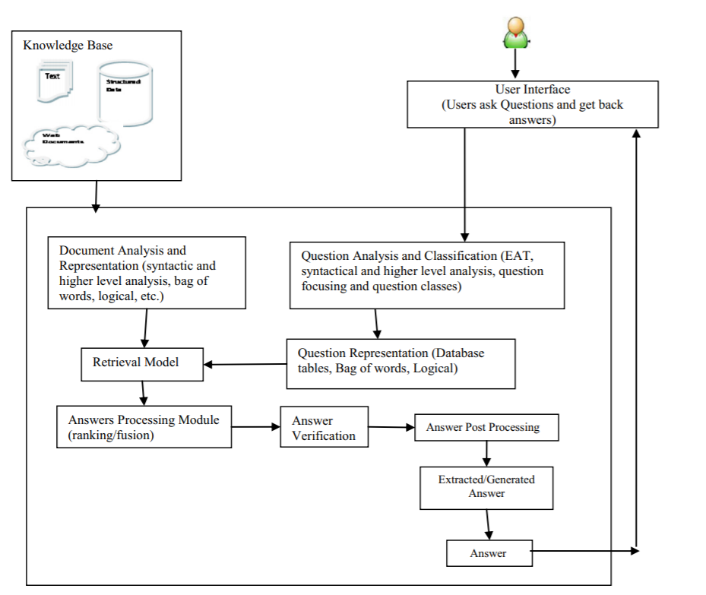
General Architecture of a QAS

Slide 4
Question Answering System (QAS)
A typical Question Answering System, consists of three main modules:
Question Analysis
Answer Retrieval
Answer Generation.

Slide 5
Classification of Question Answering System
There are eight criteria in support of classifying the available large number of QASs.
These criteria are
1. Application domains for which QASs are developed
2. Types of questions asked by the users
3. Types of analyses performed on users’ questions and source documents
4. Types of data consulted in data sources
5. Characteristics of data sources
6. Types of representations used for questions and their matching functions
7. Types of techniques used for retrieving answers
8. Forms of answers generated by QASs

Slide 6
1. Classification based on application domain
The task of generating answers of questions is related to the type of questions asked.
General information on a general topic
Specific information from a particular application domain.

Slide 7
General domain (Open Domain) QASs
It search for answers within a large document collection.
QASs exploit general ontology and world knowledge for generating answers.
The quality of answers delivered is not high.

Slide 8
Pros of general domain QASs
General domain QASs use a general dictionary.
No domain knowledge needed for formulating questions.
Wikipedia or news text can be utilized as a source

Slide 9
Cons of general domain QASs
The quality of answers is low.
The answers satisfaction depends upon the users.
For domain experts, restricted domain QASs may be more suitable.

Slide 10
Restricted Domain (Closed Domain) QASs
It answers domain specific questions.
Answers are searched within domain specific document collections.
Repository of question patterns is very limited and hence the systems can achieve good accuracy .
QASs exploit domain specific ontology and terminology.
The quality of answers is expected to be high.

Slide 11
Restricted Domain (Closed Domain) QASs
There are various restricted domain QASs developed are:
Temporal domain QAS
Geospatial domain QAS
Medical domain QAS
Patent QAS
Community based QAS, etc.

Slide 12
Pros of restricted domain QASs
Restricted domain QASs suite to domain expert users as they need specialized answers.
The quality of answers generated by restricted domain QASs is high
The level of satisfaction of the users depends on their domain knowledge.

Slide 13
Cons of restricted domain QASs
There is a limited repository of domain specific questions.

Slide 14
2. Classification based on Types of Questions
The different categories are
1. Factoid type questions
2. List type questions
3. Hypothetical type questions
4. Confirmation questions
5. Causal questions.

Slide 15
Factoid type questions [what, when, which, who, how]
These questions are simple and fact based that require answers in a single short phrase or sentence.
The factoid type questions generally start with wh-word.
Current QASs have got a satisfactory performance in answering factoid type questions.

Slide 16
List type questions
The list questions require a list of entities or facts in answers e.g., – list name of employees getting salary more than 5K?
QASs consider such questions as a series of factoid questions which are asked ten times one after the other.
The previous answers are ignored while firing next questions by QASs.
QASs generally observe a problem in fixing the threshold value for the number or quantity of the entity asked in list type questions.

Slide 17
Hypothetical type questions
Hypothetical questions ask for information related to any hypothetical event.
They generally begin with ‘what would happen if’. QASs require knowledge retrieval techniques for generating answers.
Moreover, the answers are subjective to these questions.
There are no specific correct answers to these questions.

Slide 18
Confirmation questions
Confirmation questions require answers in the form of yes or No.
Systems require inference mechanism, world knowledge and common sense reasoning to generate answers.

Slide 19
Causal questions [how or why]
Causal questions require explanations about an entity.
The answers are not named entities as observed in the case of factoid type questions.
QASs require advanced natural language processing techniques to analyze the text at pragmatic and discourse level for generating answers.

Slide 20
Text Categorization/ Text Classification

Slide 21
Text Categorization
The goal in automatic text classification is to assign a document to a category by evaluating its text components.
The dataset is split into training and testing dataset for the classification process.
Then starts the actual processing of text data.

Slide 22
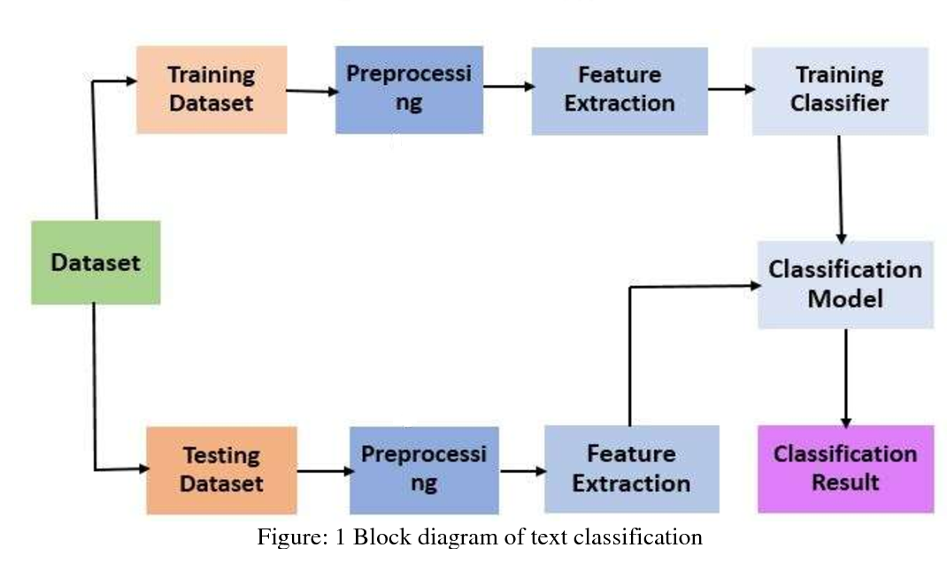
Text Categorization

Slide 23
Text Preprocessing
The main objective of pre-processing is to obtain the key features or key terms from stored text documents
Pre-processing step is crucial in determining the quality of the classification.
It is important to select the significant keywords that carry the meaning and discard the words that do not contribute for classification task.
The pre-processing phase converts the original textual data in a data mining ready structure.

Slide 24
Text Preprocessing
In general, text can be represented in two separate ways.
The first is as a bag-of-words, in which a document is represented as a set of words, together with their associated frequency in the document.
In this process, a text is represented as the container of its words, disregarding grammar and even word order but keeping multiplicity.
The bag-of-words model is commonly used in document classification(here the (frequency of) occurrence of each word is used)
The second method is to represent text directly as strings(a sequence of words)

Slide 25
1. Tokenization
Tokenization is a pre-processing method which breaks a stream of text into words, phrases, symbols, or other meaningful elements called tokens.
Example :
After sleeping for four hours, he decided to sleep for another four.
The tokens are as follows:
{ “After” “sleeping” “for” “four” “hours” “he” “decided” “to” “sleep” “for” “another” “four” }.

Slide 26
2. Stop Word Removal
Removes insignificant words such as {“a”, “about”, “above”, “across”, “after”, “afterwards”, “again”,. . .}.

Slide 27
3. Capitalization
The most common approach for dealing with inconsistent capitalization is to reduce every letter to lower case.
Exception : Problem for the interpretation of some words (e.g., “US” (United States of America) to “us” (pronoun)).
Slang and abbreviation converters can help account for these exceptions.

Slide 28
4. Slang and Abbreviation
A common method for dealing with these words is converting them into formal language.

Slide 29
5. Noise Removal
Removes punctuation and special characters.

Slide 30
6. Spelling Correction
Spelling correction is an optional pre-processing step.
Typos (short for typographical errors) are commonly present in texts and documents, especially in social media text data sets (e.g., Twitter).

Slide 31
7. Stemming
In NLP, one word could appear in different forms (i.e., singular and plural noun form) while the semantic meaning of each form is the same.
For example, the stem of the word “studying” is “study”.

Slide 32
8. Lemmatization
Lemmatization is a NLP process that replaces the suffix of a word with a different one or removes the suffix of a word completely to get the basic word form (lemma).

Slide 33
Feature Extraction
The common techniques of feature extractions are
Term Frequency-Inverse Document Frequency (TF-IDF)
Term Frequency (TF)
Word2Vec
Global Vectors for Word Representation (GloVe).

Slide 34
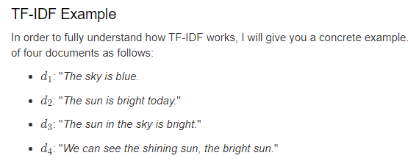
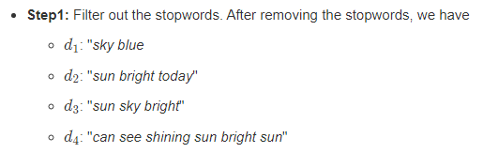

Slide 35
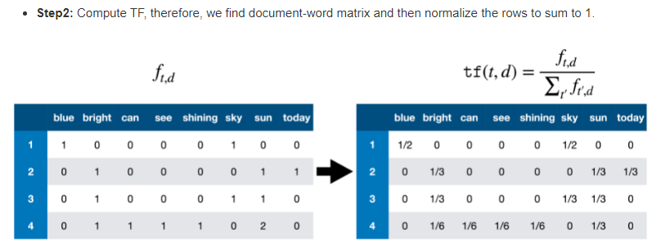

Slide 36
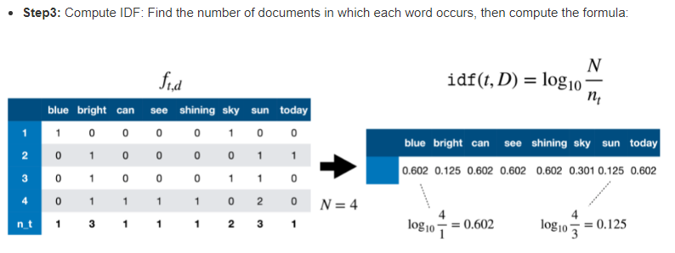

Slide 37
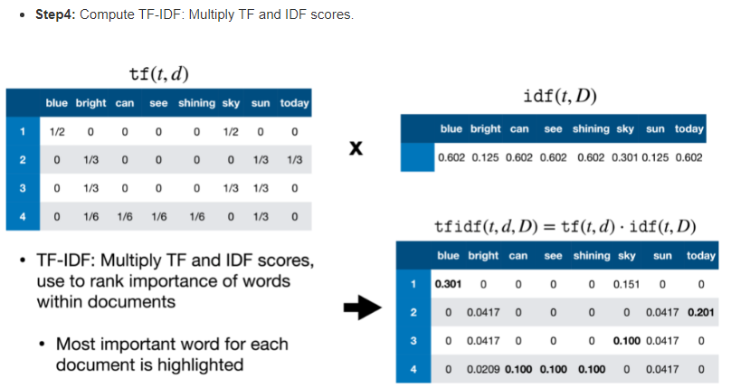

Slide 38
Reference
https://sci2lab.github.io/ml_tutorial/tfidf/

